Slide 1
Course Project: Shiny Application and Reproducible Pitch
Omar Abedin
April 15, 2019

Slide 2
About the Course Project
This is a deliverable for the course Developing Data Products as part of the Coursera Data Science Specialization.
Instructions:
Write a shiny application with associated supporting documentation. The documentation should be thought of as whatever a user will need to get started using your application.
Deploy the application on Rstudio's shiny server
Share the application link by pasting it into the provided text box
Share your server.R and ui.R code on github

Slide 3
How to use the application
Using the data provided by Galton Families dataset, we fit a linear model to predict a child's height based on the gender and parent's average height.
The application is running on (https://r2po.shinyapps.io/course_project_shiny_appreproducible_pitch/)
ui.R, and Server.R Code in my github repository (https://github.com/omar-abedin/Shiny-Application-and-Reproducible-Pitch)

Slide 4
Galton Families Dataset
The data used in the app comes from the Galton Families dataset.

Slide 5
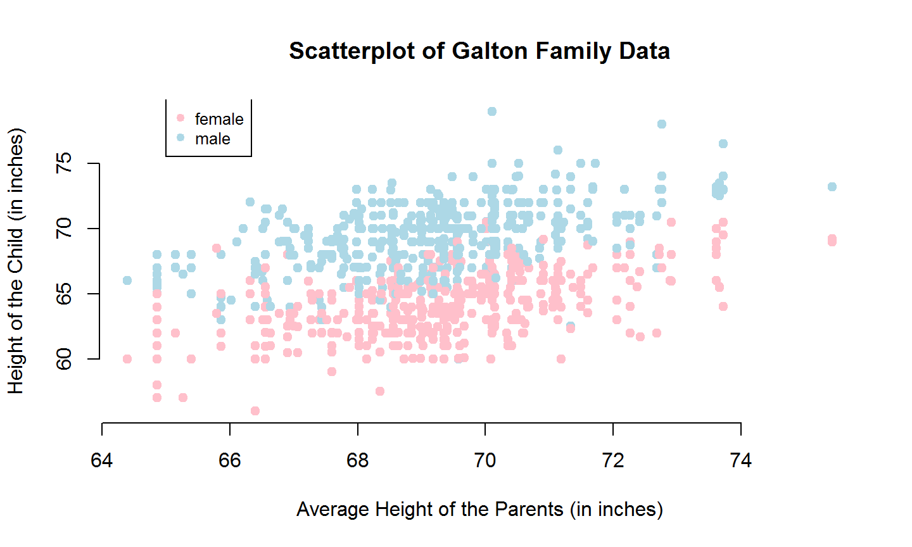
Plot
In the scatterplot below are represented the data used for the prediction model

